Slide 1
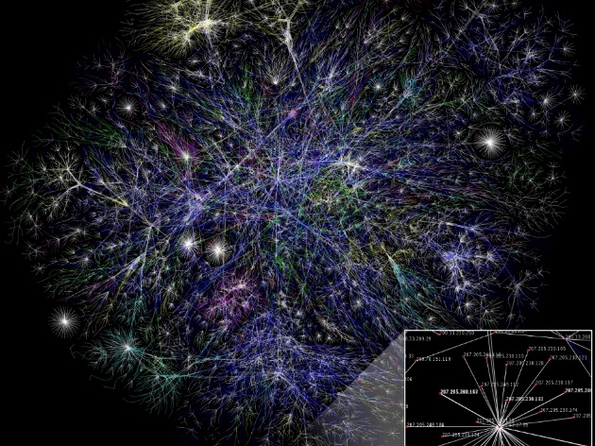
Routing in Optical Networks
Chapters 3: J. M. Simmons,
Optical Network Design and Planning, Optical Networks,
© Springer International Publishing 2014

Slide 2
Introduction-cont’d
Telecommunications networks are generally so large and complex to manually design a network in a reasonable time-frame is prohibitively difficult
Rely on automated algorithms :
How to route traffic through the network
How to protect the traffic
how to bundle the traffic into wavelengths

Slide 3
Introduction
In systems with optical bypass, additional algorithms are needed to handle regeneration
When designing network algorithms, it is important
to consider the size of the problem:
number of network nodes
(i.e. Metro-core networks VS backbone networks)
amount of traffic carried in the network
Metro-core WDM networks generally have no more than 40 wavelengths per fiber, whereas backbone networks typically have 80 (or as many as 160) wavelengths per fiber
system specifications

Slide 4
Introduction-cont’d
The run time of the network planning algorithms is very important
In a dynamic real-time environment, a new connection may need to be established in less than 1s
(need to be completed in less than 100 ms )
How about long-term network planning?
Designing an optimal network with heuristics
experience has shown produce very good, not
always optimal though, results and run in a reasonable
time-frame

Slide 5
Sequential steps in the planning process
Routing
Regeneration
Wavelength assignment

Slide 6
Routing
Routing is the process of selecting a path through the network for a traffic demand, where there are typically many possible paths to get from the demand source to the demand destination
Metrics:
Cost / path distance / number of links

Slide 7
Routing, cont’d
The chapter is not meant to be a review of all known routing algorithms and strategies
Much of the chapter is equally applicable to a network with optical bypass as to a network based on (O-E-O) technology
One source and one destination over a single path
Multicast routing, from one source to multiple destinations
“Manycast,” where one source communicates with any N of the
M possible destination nodes

Slide 8
Shortest-Path Algorithms
Routing strategies to determine which path minimizes a particular metric
Metrics are additive!
Example 1:
Assume that each link is assigned a metric of unity. The shortest-
path algorithm is to find the path that traverses the fewest hops
The term hop is often used to refer to each link in a path
Example 2:
Assume that each network link has a certain probability of being available. The link
metric can be chosen to be the negative of the logarithm of the link availability convert a
multiplicative metric to an additive metric Higher link availability corresponds to a
smaller link metric so shortest-path algorithm leads to the path with the highest availability

Slide 9
Shortest-Path Algorithms, cont’d
A well-known shortest-path algorithm is Dijkstra
(a “greedy” algorithm ) choosing the optimal
option at each step without considering future
steps
Another shortest-path algorithm is the breadth-first-search (BFS)
If there is a unique shortest path from source to destination, the BFS and Dijkstra algorithms produce the same result

Slide 10
Shortest-Path Algorithms, cont’d
If there are multiple paths that are tied for the
shortest, the BFS algorithm finds the shortest path
with the fewest number of hops
Fewer hops can potentially translate into lower cost or less wavelength contention
BFS works with negative link metrics
Undirected network : (Bidirectional Link) a shortest path from source to destination also represents, in reverse, a shortest path from destination to source

Slide 11
Shortest-Path Algorithms, cont’d
KSP algorithms find the shortest path between the source and
destination, the second shortest path, … until the K ^{th} shortest
path is found or until no more paths exist.
Not necessarily completely disjoint from each other
Constrained shortest-path (CSP) :
Constraints are placed on the desired path, example:
Searching for the shortest-path subject to all links of the path
having at least N wavelengths free
CKSP
Restricted shortest-path (RSP)
Multi-constrained path (MCP)

Slide 12
Routing Metrics, cont’d
Two common strategies are finding the path with
The fewest hops
The shortest distance

Slide 13
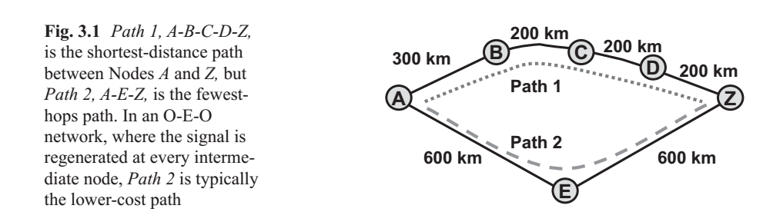
Routing Metrics, cont’d
Minimum-Hop Path Versus Shortest-Distance Path
In a pure O-E-O network, a connection is electronically terminated (i.e., regenerated) at every intermediate node along its path searching for the path from source to destination with the fewest hops is generally favored as it minimizes the amount of required regeneration

Slide 14
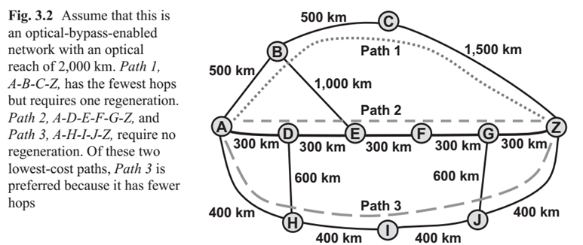
Routing Metrics, cont’d
In networks with optical bypass, regeneration is determined
by the system optical reach, which is typically based on distance
Example, an optical reach of 2,000 km indicates the connection
can travel no further than 2,000 km before it needs to be
regenerated
Overall, a good strategy for optical-bypass systems is to search for a route based on distance, but of the paths that meet the minimal regeneration, favor the one with the fewest hops

Slide 15
Routing Metrics, cont’d
Shortest-Distance Path
Versus
Minimum-Regeneration Path
The path with shortest physical distance is not necessarily the path with minimum regeneration
If the optical reach of the system is shorter than the distance between two nodes: deploy a dedicated regeneration site along the link where all transiting traffic is regenerated

Slide 16
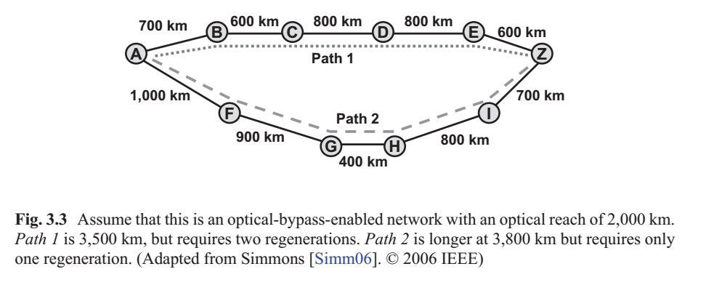
Routing Metrics, cont’d
Another factor that affects the amount of regeneration is whether the network fully supports optical bypass in all directions at all nodes
There may be some nodes not fully equipped with optical-bypass equipment:
Nodes equipped with ROADM and an optical terminal (regardless of the
distance over which it has been transmitted)

Slide 17
K-Shortest Paths
It is often advantageous to generate a set of candidate paths
Roughly speaking, in an O-E-O network, paths that have the same number of hops have an equivalent cost because the number of required regenerations is the same
Run a KSP algorithm with the metric set to unity for all links

Slide 18
Bottleneck-Avoidance Strategy
While the KSP technique can generate a set of lowest-cost paths, the paths that are found may not exhibit good link diversity
The first step is to determine the network links that are likely to be highly loaded (i.e., the “hot spots”)
It is important to consider not just single links that are likely to be bottlenecks, but also sequences of consecutive links that may be heavily loaded, and find routes that avoid the whole sequence of bad links

Slide 19
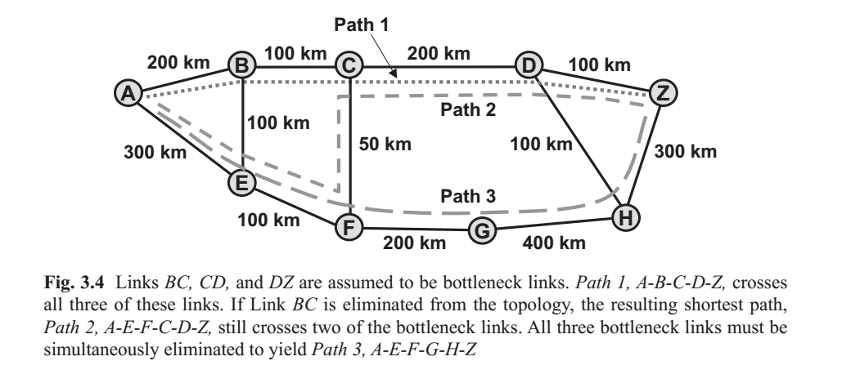
Bottleneck-Avoidance Strategy
The next step is to run the shortest-path algorithm multiple times, where in
each run one bad link or one bad sequence of links is removed from the topology
This process finds paths that avoid particular bottleneck areas, if possible

Slide 20
Routing Strategy
Strategies for selecting one of the paths to
use for a given demand
In optical-bypass-enabled networks, selecting a wavelength for the route is an important step of the planning process.
Selecting a route independent of wavelength assignment

Slide 21
Fixed-Path Routing
The set of candidate paths is generated prior to any demands being added to the network (For each source/destination pair)
For each source/destination pair, one path is chosen from the associated candidate path set. Ideally, the path is a lowest-cost path.
No opportunity to adapt to the current network state !!!
The main motivation for using shortest-path routing is minimization of the end-to-end path latency. For applications such as electronic trading in the financial markets, with a latency of even a few microseconds can be unacceptable

Slide 22
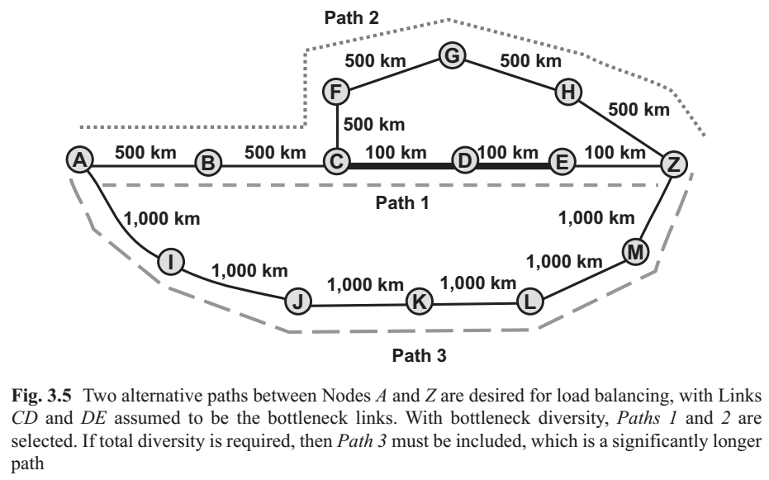
Alternative-Path Routing
The set of candidate paths is also generated prior to any demands being added to the network.
One of the M paths is selected to be used for that particular demand, leading to some degree of state-dependent routing!

Slide 23
Selecting a Path for a Demand Request
When a demand request arrives for a particular source/destination, any of the M paths can be potentially used to carry the connection
Typically, the current state of the network is used in determining which of the M paths to use
Least congested path routing : select the feasible path that will leave the network in the “least-loaded” state
Different strategies to choose the optimal path

Slide 24
Dynamic-Path Routing
Also called adaptive unconstrained routing
There is no predetermination of which paths to use for a particular source/destination combination
The path calculation is performed at the time of each demand request, based on the current state of the network

Slide 25
Dynamic-Path Routing
The first step is to determine if there are any links in the network with insufficient available bandwidth to carry the new demand
Any node that does not have available regeneration equipment should be temporarily removed from the topology, (regeneration would be required)
After the topology has been pruned based on the current network state, i.e., the KSP algorithm can be run and/or the bottleneck-avoidance strategy can be used
This process takes tens of milliseconds to complete, so it is possible to generate a candidate set of paths every time a new demand request is received

Slide 26
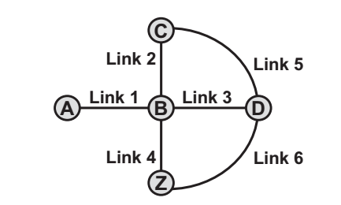
Capturing the Available Equipment in the Network Model
Due to a lack of available equipment in particular nodes, some, or even all, of the candidate paths may be infeasible
The dynamic routing process first prunes out the links and nodes that would clearly be infeasible for a new demand
Example: O-E-O Network it is assumed that pairs of transponders are interconnected via patch cables rather than through a flexible switch :

Slide 27
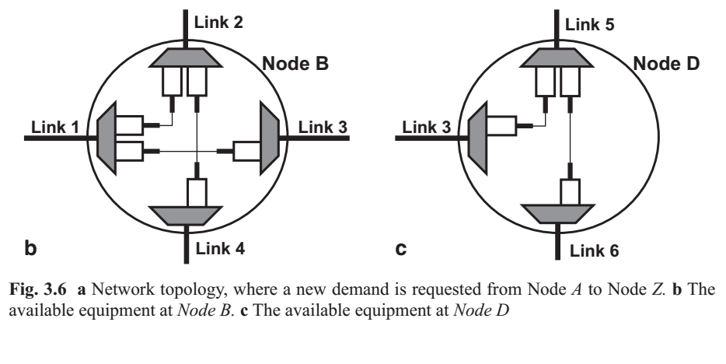
Capturing the Available Equipment in the Network Model

Slide 28
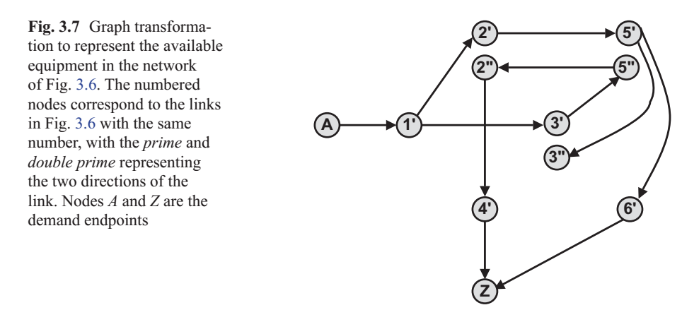
Capturing the Available Equipment in the Network Model
Perform a graph transformation where each link in the original topology becomes a node in the new topology
These nodes are interconnected in the new topology only if there is equipment available in the real network to allow a new path to be routed between them

Slide 29
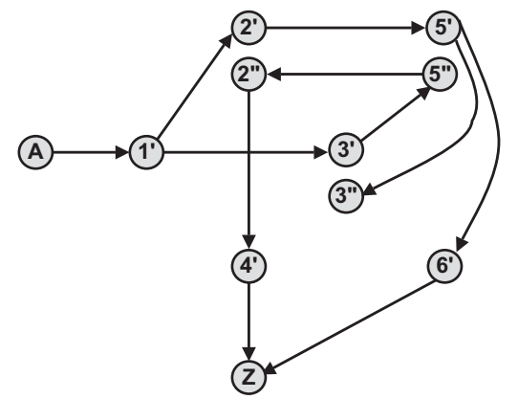
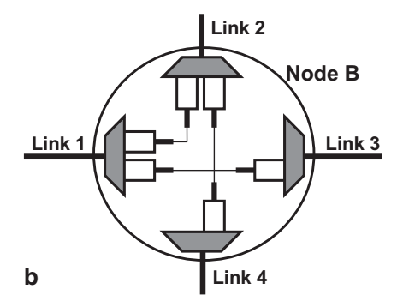
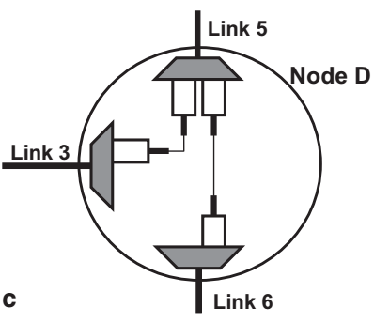
Capturing the Available Equipment in the Network Model

Slide 30
Capturing the Available Equipment in the Network Model
A shortest-path algorithm is run on the transformed
topology to find a feasible path, using unity as the
link metric to minimize the number of hops, and
hence minimize the number of regenerations
The desired path from Node A to Node Z in the
transformed graph is A-1′-2′-5′-6′-Z, which
corresponds to path A-B-C-D-Z in the original graph
Turn constraints : Routing constraints such as those
imposed by the available transponder pairs, where
only certain directions through a node are possible

Slide 31
Capturing the Available Equipment in the Network Model
Optical-Bypass-Enabled Network
A new topology is created, composed of only those nodes that have available regeneration equipment, along with the source and destination of the new demand
Even if there are multiple regeneration-free paths between a pair of nodes, only one link is added in the new topology
The resulting graph is often referred to as the reachability graph
A shortest-path algorithm is run on this transformed topology to find a feasible path

Slide 32
Capturing the Available Equipment in the Network Model
Optical-Bypass-Enabled Network
A link metric such as [LARGE+NumHops] can be used
LARGE is some number greater than any possible path hop count
NumHops is the number of hops in the minimum-hop regeneration-free path (in the real topology) between the nodes interconnected by the link
The shortest-path algorithm finds a minimum- regeneration feasible path with the minimum number of hops, assuming one exists

Slide 33
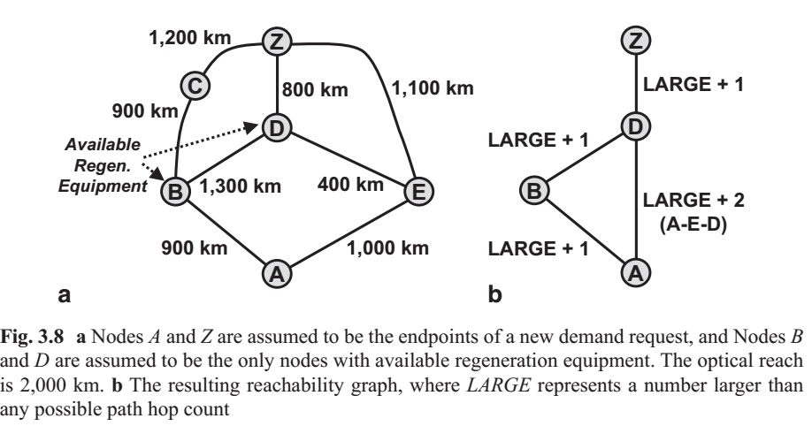
Capturing the Available Equipment in the Network Model

Slide 34
Diverse Routing for Protection
The previous sections focused on finding a single path between
a source and a destination
If any of the equipment supporting a connection fails
if the fiber over which the connection is routed is cut
the demand is brought down
Thus, it is often desirable to provide protection for a demand to
improve its availability
Availability is defined as the probability of the demand being in
a working state at a given instant of time

Slide 35
Availability
Availability % | Downtime per year | Downtime per month | Downtime per week | Downtime per day
90% ("one nine") | 36.5 days | 72 hours | 16.8 hours | 2.4 hours
95% ("one and a half nines") | 18.25 days | 36 hours | 8.4 hours | 1.2 hours
97% | 10.96 days | 21.6 hours | 5.04 hours | 43.2 minutes
98% | 7.30 days | 14.4 hours | 3.36 hours | 28.8 minutes
99% ("two nines") | 3.65 days | 7.20 hours | 1.68 hours | 14.4 minutes
99.5% ("two and a half nines") | 1.83 days | 3.60 hours | 50.4 minutes | 7.2 minutes
99.8% | 17.52 hours | 86.23 minutes | 20.16 minutes | 2.88 minutes
99.9% ("three nines") | 8.76 hours | 43.8 minutes | 10.1 minutes | 1.44 minutes
99.95% ("three and a half nines") | 4.38 hours | 21.56 minutes | 5.04 minutes | 43.2 seconds
99.99% ("four nines") | 52.56 minutes | 4.38 minutes | 1.01 minutes | 8.64 seconds
99.995% ("four and a half nines") | 26.28 minutes | 2.16 minutes | 30.24 seconds | 4.32 seconds
99.999% ("five nines") | 5.26 minutes | 25.9 seconds | 6.05 seconds | 864.3 milliseconds

Slide 36
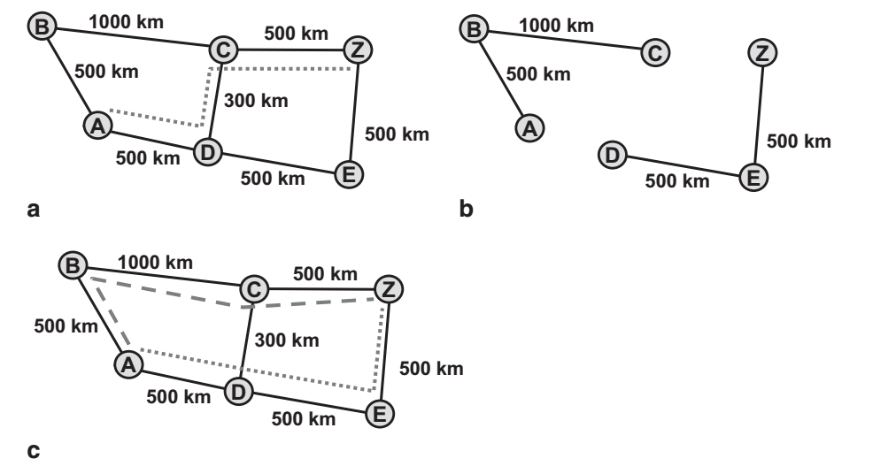

Diverse Routing for Protection
The two paths should be disjoint to ensure that a single failure does not bring down both paths

Slide 37
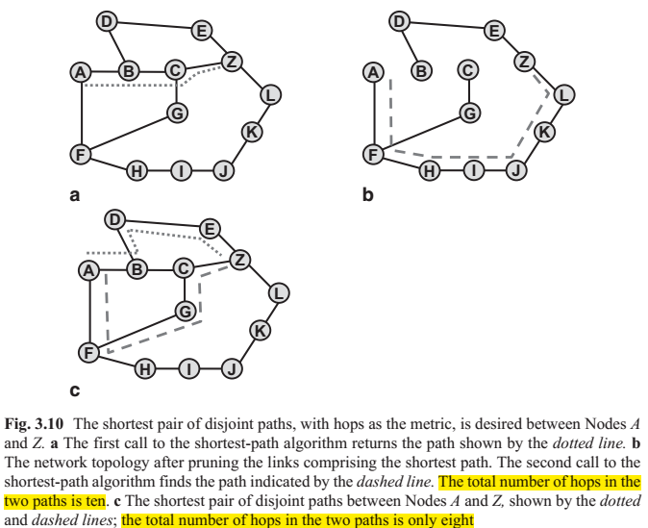

Diverse Routing for Protection

Slide 38
Diverse Routing for Protection
Shortest Pair of Disjoint Paths (SPDP)
Shortest is defined as the pair of paths where the sum of the metrics on the two paths is minimized
Both the Suurballe and the Bhandari algorithms are guaranteed to find the pair of disjoint paths between a source and destination
The SPDP algorithms can be used to find either the shortest pair of link disjoint paths or the shortest pair of link-and-node-disjoint paths
The SPDP algorithms can be extended to search for the N shortest disjoint paths between two nodes, for any N, where the N paths are mutually disjoint

Slide 39
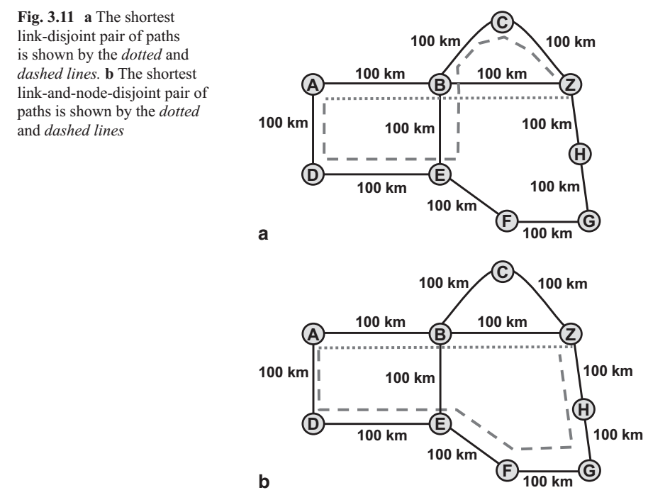
Diverse Routing for Protection

Slide 40
Diverse Routing for Protection
Minimum-Regeneration Pair of Disjoint Paths
The paths of minimum distance in an optical-bypass enabled network do not necessarily correspond to the paths of minimum regeneration.
The heuristic requires a graph transformation, where a reachability graph is created with links added between any pair of nodes that have a regeneration-free path between them
Another effective (and simple) heuristic is to take the shortest-distance dual paths produced by the SPDP algorithm, and one at a time, eliminate a link included in these paths

Slide 41
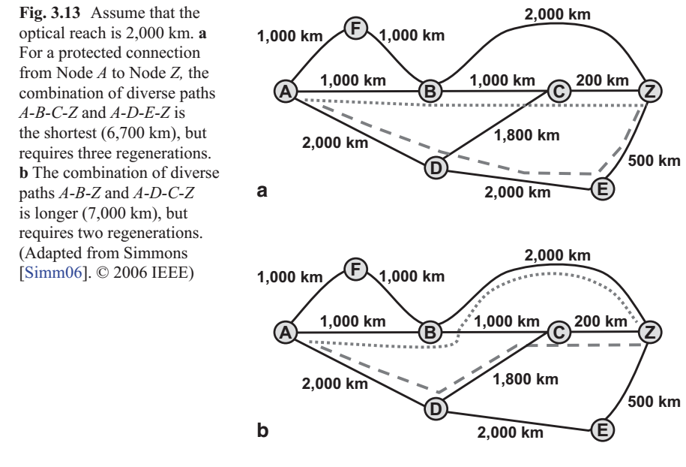
Diverse Routing for Protection

Slide 42
Diverse Routing for Protection
Shortest Pair of Disjoint Paths:
Dual Sources/Dual Destinations
Another interesting twist to the problem of finding the shortest pair of disjoint paths arises when there are two sources and/or two destinations

Slide 43
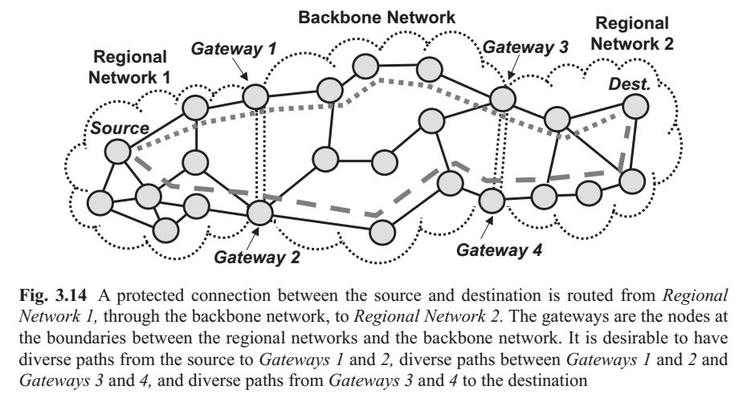
Diverse Routing for Protection

Slide 44
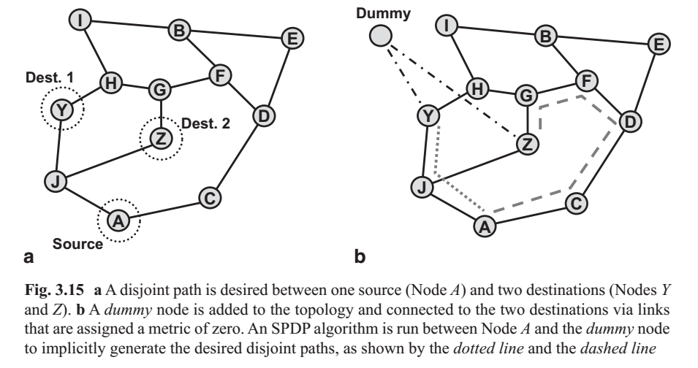
Diverse Routing for Protection

Slide 45
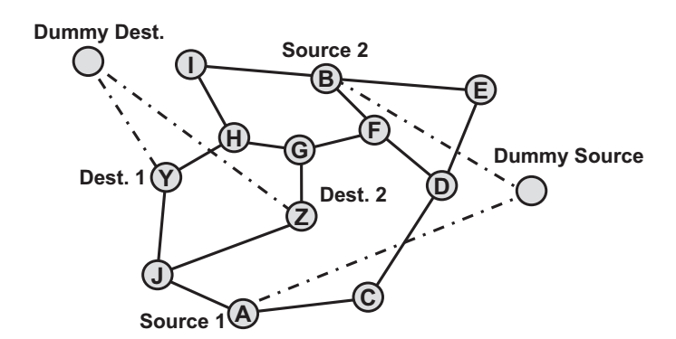
Diverse Routing for Protection

Slide 46
Diverse Routing for Protection
Shared Risk Link Groups When searching for disjoint paths for protection, it may be necessary to consider the underlying physical topology of the network in more detail
Two links that appear to be disjoint when looking at the network from the link level may actually overlap at the physical fiber level
There may be network resources other than links that fail as a group
A common SRLG configuration, known as the fork configuration, occurs when multiple links lie in the same conduit as they exit/enter a node

Slide 47
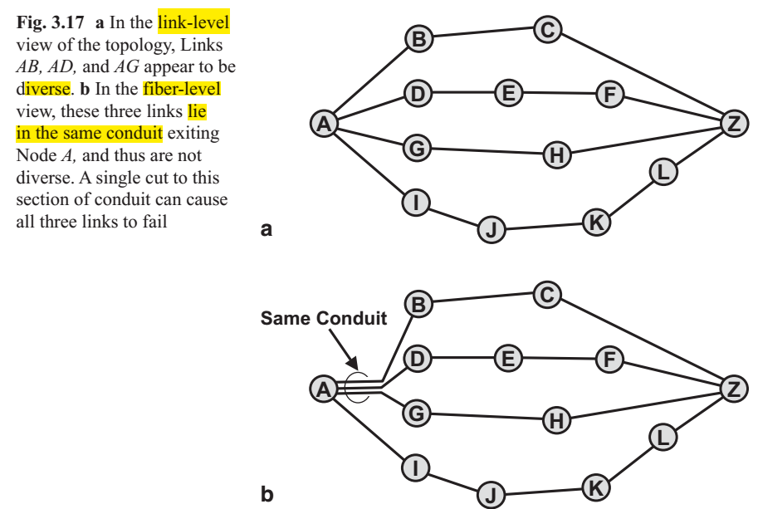
3.7 Diverse Routing for Protection

Slide 48
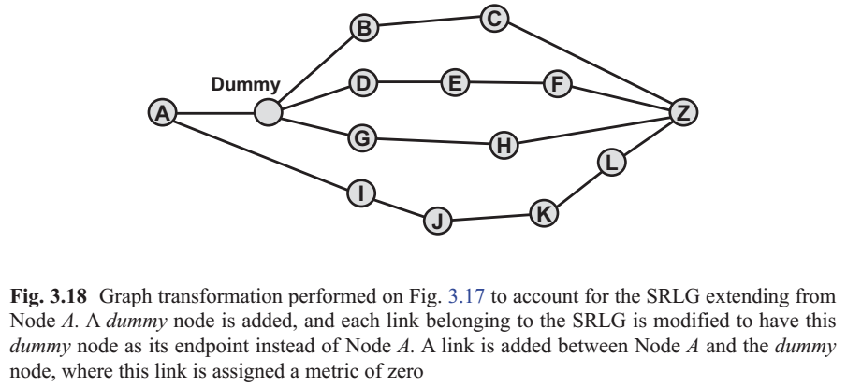
Diverse Routing for Protection

Slide 49
Diverse Routing for Protection
In general, there are no computationally efficient algorithms that are guaranteed to find the optimal pair of disjoint paths in the presence of any type of SRLG Thus:
heuristics are generally used when “difficult” SRLGs are present in a network
Routing Strategies with Protected Demands
Any of the three routing strategies discussed in Sect. 3.5—fixed-path routing, alternative- path routing, and dynamic-path routing—are applicable to protected demands

Slide 50
Routing Order
One common strategy is to order the demands based on the lengths of the shortest paths for the demands
where the demands with longer paths are processed first
Because longer paths are harder to accommodate

Slide 51
Flow-Based Routing Techniques
With global optimization techniques such as integer linear programming (ILP), the routing order of the demands is not relevant
ILP implicitly considers the whole solution space to find the optimal solution
A more practical approach is to use efficient linear programming (LP) techniques (e.g., the Simplex algorithm), combined with strategies that drive the solution to integer values
For example, routing a set of traffic demands can be formulated as a multicommodity flow (MCF) problem

Slide 52
Multicast Routing
Multicast traffic involves one source communicating with multiple destinations, where the communication is one-way
point-to-multipoint
The multicast tree connects the source to each of the destinations (without any loops), such that just one copy of the signal is sent on any link of the tree
A tree that interconnects the source and all of the destinations is known as a Steiner tree

Slide 53
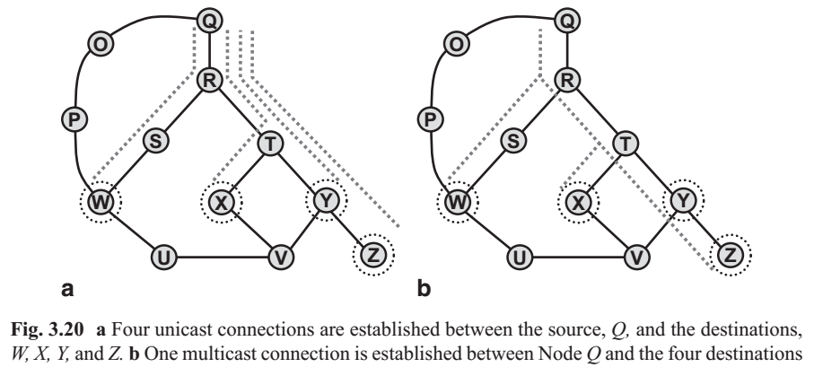
Multicast Routing

Slide 54
Multicast Routing
Minimum Spanning Tree with Enhancement
A minimum spanning tree is a tree that touches all nodes in the topology where the sum of the metrics of the links comprising the tree is minimized. This is different from a minimum Steiner tree in that all nodes are included and is easier to solve
Each link in the resulting minimum spanning tree, where a link connects two nodes i and j, is expanded into the shortest path in the true topology between nodes i and j

Slide 55
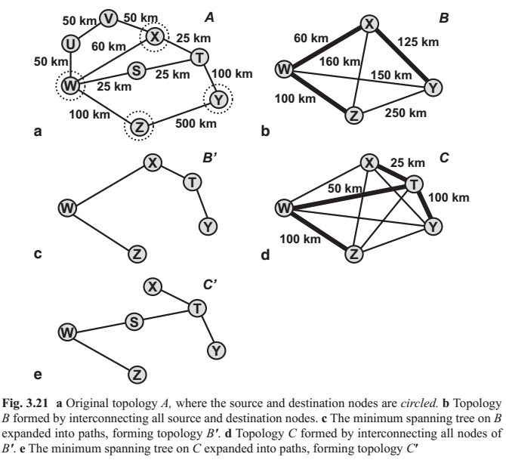
Multicast Routing
Minimum Spanning Tree with Enhancement

Slide 56
Multicast Routing
Minimum Paths
In contrast to the MSTE heuristic, the MP heuristic may produce different results depending upon which node is the source node
The first step in MP is to begin building a tree, where initially the tree is composed of just the source node
the destination node that is closest to any of the nodes already in the tree is added to the tree, along with the shortest path between the tree node and that destination node
continues until all destination nodes have been added to the tree, resulting in a multicast tree

Slide 57
Multicast Routing
Minimum Paths
To improve the performance of MP, the algorithm can be run N+1 times
N is the number of destination nodes
in each run a different node is designated as the “source” node

Slide 58
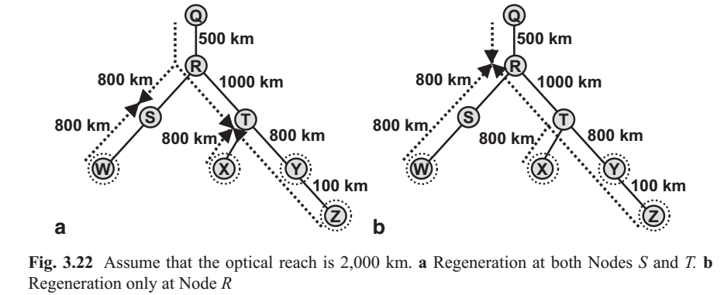
Multicast Routing
Regeneration in a Multicast Tree
Note that optical bypass does not permit the wavelength of the signal to be changed, except when the signal is regenerated
It may make wavelength assignment difficult

Slide 59
Multicast Routing
Multicast Protection
providing protection for a multicast connection such that the source remains connected to each of the destinations under a failure condition
One simplistic approach is to try to provision two disjoint multicast trees between the source and the destinations
Another protection approach is to arbitrarily order the multicast destinations, and then sequentially find a disjoint pair of paths between the source and each destination, using an SPDP algorithm
Network coding, where the destinations receive independent, typically linear, combinations of signals over diverse paths

Slide 60
Multicast Routing
Manycast
one source communicates with any N of the destination nodes, for some specified N
This could be useful, for example, for distributing huge data sets that require processing
If N equals one, the problem is referred to as anycast
for example, with cloud computing, where particular data
resources and applications are replicated in a set of M data
centers
The cloud user (e.g., an enterprise) needs to access any one of the M data centers, ideally via a low-latency path

Slide 61
Multipath Routing
Typically, a demand between two endpoints is routed over a single path in the optical layer
There are scenarios where it is beneficial to split the aggregate signal of the demand into lower-rate signals, with each lower-rate signal potentially being transmitted over a different path from source to destination
The process of splitting the aggregate signal into lower- rate signals is known as inverse multiplexing
ITU supports inverse multiplexing in the optical layer (e.g., in SONET/SDH or OTN) is Virtual Concatenation (VCAT), a 40-Gb/s demand to be split into four 10-Gb/s signals

